Slide 1


Barnet PE Subject Leaders
Thursday 17th September2026 (9am to 12pm)
@ St Catherines’ Primary School
Kim Henderson
consult@kimhenderson.co.uk
Welcome!

Slide 2
Agenda
Welcome and meeting colleagues
Celebrating progress and good practice
PE Premium update and new partnerships – what does this mean for our schools in Haringey
Community partnerships in Barnet
SGO update
NCPE update
Resources – Oak Academy
H&S updates – Martyn’s Law – Safe practice / AfPE / QM
CPD calendar
AOB

Slide 3
What are your highlights from last year?
Any success stories / small wins – curriculum / extra curricular?
Your role?
Pupil voice?
Staff subject knowledge, confidence and motivation - CPD?

Slide 4
Autumn term 2026
Share your key tasks and challenges for this term
EYFS – physical competence and needs of your new starters?
Transition between phases?
Needs of different year groups , specific groups?

Slide 5
National update
During the 2026/27 Academic Year, the Primary PE and Sport Premium model will be phased out. Funding in place to support this transition (effectively two terms of PE Premium). In its place will be a new PE and School Sport Partnerships Network.
The School Games Organisers Network is now funded to the end of the 26/27 Academic Year (ending in July 27)

Slide 6
PE Premium monitoring and tracking tools
Advice on Primary PE and Sport Premium - Association for Physical Education
PE and sport premium guidance for primary schools - GOV.UK

Slide 7
What should we do this year re. accountability?

Slide 8
Additional transition funding announced
Following engagement with schools, trade unions and the physical activity sector about the transition between the two models, the Department has announced a rebalancing of funding. This increases funding for the transition period in the 2026/27 Academic Year from £100m to £150m, to deliver a smoother transition.
Schools will receive a one-off payment in the Autumn to be spent across the 2026/27 Academic Year, with the guidance and conditions of the grant published in September.
Meanwhile, procurement for a National Delivery Partner for the PE and School Sport Partnerships Network is expected to begin soon, with the successful bidder announced in November.
The new Network will then get up and running from January, with the National Delivery Partner engaging with schools and local partnerships to understand their needs before delivering support from April 2027 onwards.

Slide 9
The Network will include three school support pathways:
Universal Offer – support available to all eligible schools, including Continued Professional Development (CPD), guidance, resources and sector signposting.
Targeted Intervention – additional support directed by the National Delivery Partner to schools or pupil groups identified as having the greatest need.
School-Requested Intervention – support requested by schools based on identified local need, to be considered by the National Delivery Partner in accordance with eligibility criteria, available capacity and the overall objectives of the Partnerships Network.

Slide 10
Community provision in Barnet
Do you know what is available in your local community?
Which local partners are you already working with?
What are your children engaging in beyond school provision?

Slide 11
BPSS
Team News:
Jo Eames – Strategic Manager & East SGO- j.eames@qegschool.org.uk
Katie Knight - SGO South - KBa@clarion.school
Caroline Connell – SGO West - cconnell@st-james.barnet.sch.uk
Jason Vassiliades – SGO Central – j.vassiliades@qegschool.org.uk
BPSS Website:
http://www.barnetpartnershipforschoolsport.co.uk/
Twitter:
@barnetsport

Slide 12
Date Event Time Venue
24th September Bronze Ambassador Training 8:30 - 12 Church Hill
6th October C4L Multi skill festival 8am - 3pm Hendon LC
8th October KS1 Inclusion Festival 12:30 - 3pm Copthall LC
9th October Y5/6 Hockey Festival 10am - 12noon Southgate HC
12th October Primary Dodgeball 8:30 - 12 Copthall LC
14th October BERFC Yr5 T1 12 - 3pm BERFC
15th October Primary Cross Country 9.30-12; 1-3 Copthall Playing Fields
3rd November "Come try it" Boccia 8:30 - 3pm Copthall LC
11th November Primary Rugby 9.30am FRFC
12th November Yr5&6 Girls Football am & pm Compton
16th November Yr5&6 Primary Netball 9:30 - 3 Copthall School
18th November BBN1 8am - 3pm Hendon LC
26th November Primary Football Mixed am & pm Compton
4th Decemeber Primary SHA am & pm Copthall LC
8th December KS1 C4L Winter Festival 8am - 3pm Stone X
Date | Event | Time | Venue
24th September | Bronze Ambassador Training | 8:30 - 12 | Church Hill
6th October | C4L Multi skill festival | 8am - 3pm | Hendon LC
8th October | KS1 Inclusion Festival | 12:30 - 3pm | Copthall LC
9th October | Y5/6 Hockey Festival | 10am - 12noon | Southgate HC
12th October | Primary Dodgeball | 8:30 - 12 | Copthall LC
14th October | BERFC Yr5 T1 | 12 - 3pm | BERFC
15th October | Primary Cross Country | 9.30-12; 1-3 | Copthall Playing Fields
3rd November | "Come try it" Boccia | 8:30 - 3pm | Copthall LC
11th November | Primary Rugby Years 5&6 | 9.30am | FRFC
12th November | Primary Rugby Years 3&4 | 9.30am | FRFC
12th November | Yr5&6 Girls Football | am & pm | Compton
16th November | Yr5&6 Primary Netball | 9:30 - 3 | Copthall School
18th November | BBN1 | 8am - 3pm | Hendon LC
26th November | Primary Football Mixed | am & pm | Compton
4th December | Primary SHA | am & pm | Copthall LC
8th December | KS1 C4L Winter Festival | 8am - 3pm | Stone X

Slide 13
BPSS Events
BPSS Leagues update
Netball and football leagues up and running
Cancellations
Before booking onto an event, please confirm that you have staff, transport and students available to be able to attend.

Slide 14

Staffing @ events
Please can we ask that ALL teams attending events ensure that a member of staff is present. This member of staff must be first aid qualified and have a kit with them.

Slide 15
Inclusive Events
1744 SEND pupils have attended a BPSS opportunity
952 SEND Pupils have taken part in specific inclusion events
585 Boys and 367 Girls
792 SEND pupils have taken part in other BPSS events
140 Leaders have been trained to support SEND events
22 Teams represented Barnet at additional North London Events
7 schools represented at the School Games Finals
Schools continuing to receive CPD and training
Is your school involved??

Slide 16
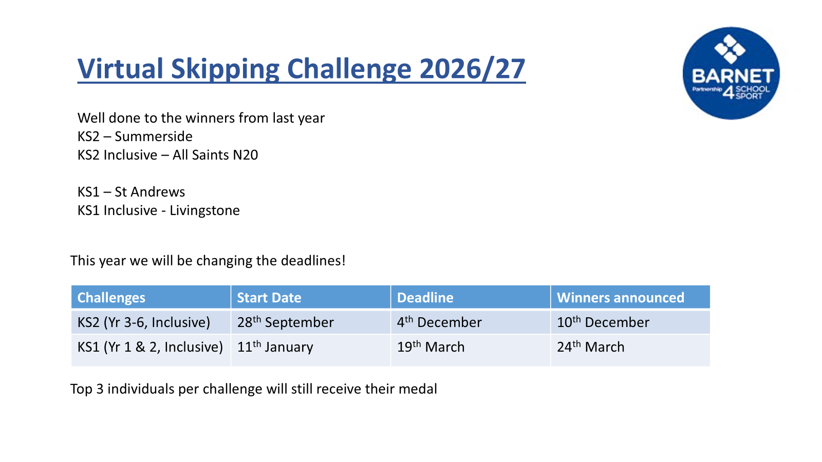

Slide 17


Slide 18
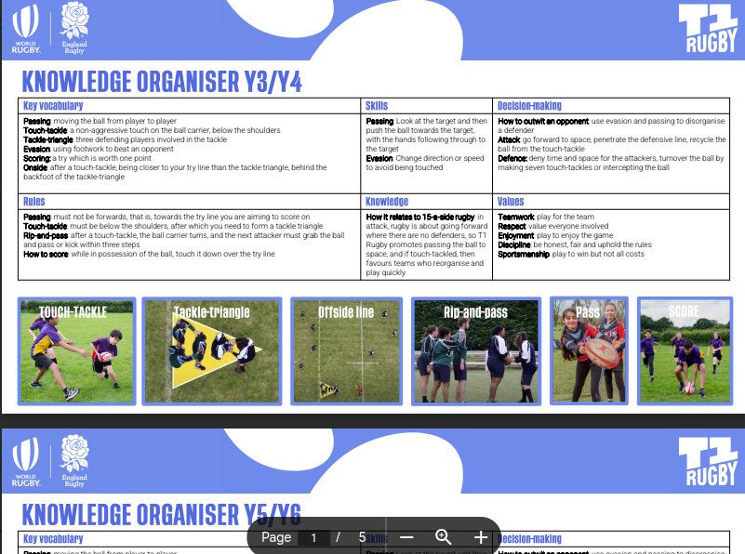
T1 Rugby - Is Here!
FREE CPD - 1st October
Festivals
Competitions
School Games
Leagues
Free Resources
Put your school forward for
the programme
Important - T1 Rules Video

Slide 19


Barclays Girls Football Partnership
What does girls football look like in your school?
Is there equal access between the boys and the girls football in your school? If not why?
What are the challenges?
Is your school signed up to the BGFSP?

Slide 20
School Games Mark 2025-26
Platinum | Gold | Gold | Silver
Livingstone | Osidge | Dollis | Blessed Dominic
Brunswick Park | Holly Park | Edgware | St Andrews
Martin Primary | Holy Trinity | St Agnes
Monkfrith | Ashmole Primary | Courtlands
St Theresa's | Church Hill | Etz Chaim | Bronze
Goldbeaters | Danegrove | Northway | Broadfields
The Orion | St Johns N11 | Barnfield
 | Copthall | Woodcroft
 | St James' | Watling Park | KS1 BPSS Mark
 | Deansbrook | All Saints NW2 | Monkfrith - Bronze
 | Underhill | SMSJ

Slide 21
Whole National Curriculum update
Reinforcing the importance of 2 hours of PE every week for every child
SEND adaptations
Compulsory Citizenship Years 1 to 6
Access to enriching activities ie. Sport
Greater focus on oracy

Slide 22
Threads of Learning (from Oak Academy)
Our PE threads that weave through both our primary and secondary curricula are:
MOVE: movement competence; physical fitness; application of tactics, strategies and compositional ideas; performance and competition
THINK: knowledge of rules, tactics, strategies and compositional ideas; knowledge of healthy, active living; decision making, problem solving and creative thinking; evaluation, analysis and reflection
FEEL: personal and emotional; engagement and enjoyment
CONNECT: teamwork and leadership; cultural and ethical awareness

Slide 23
AfPE position paper - national subject association message to Government
PE to be a core subject in the NC for 3-18 year olds
At least 2hrs PE for every student, every week, every year
PE to be at the heart of school life
Transformed and transformational PE curriculum: ambitious, fit for purpose, equitable, learner centred
Notes:
Heart of school life - how can we achieve this at your school– what are whole school drivers – how can we play our part – emotional WB / mental health? Readiness to learn effectively? Building confidence and resilience – what do we do best – how do we share with SLT? Oracy?
Transformed and transformational - what do we think is our purpose - (are all your students getting a good deal – girls, SEND, disadvantaged – these are key drivers at the moment - how much independence do you develop in your students so that they are well equipped to be more PA in their lives beyond us or do we just get them to do as we say??? Do they understand our vision / purpose? Do they feel it is relevant for them? Is it appealing for all of them?

Slide 24
Aims (afPE curriculum, 2025)
Develop movement competence and confidence across a broad spectrum of activity contexts
Evaluate and appreciate achievement and progression of movement skills, concepts and strategies
Develop personal and interpersonal attributes through purposeful, challenging and enjoyable physical activity
Adopt a lifelong and life-wide habit of being active, regardless of background

Slide 25
Intended Timeframe
Autumn 2026 : public consultation
Spring 2027: final published National Curriculum content
September 2027: first teaching on ITE programmes – optional teaching of content in schools
September 2028: statutory content for delivery in schools
September 2030: Phase 2 (PE and Dance) GCSE teaching

Slide 26
Teaching Autumn term activities - resources
Oak Academy
Free KS2 Physical education teaching resources | YAll, 3, 4, 5, & 6 | Page 1 of 3 | Oak National Academy
Lesson examples – share
Free Primary Physical education Lesson & Curriculum Resources | Oak National Academy

Slide 27
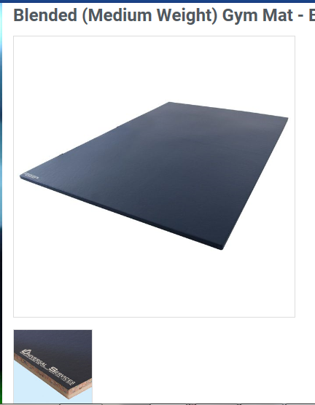
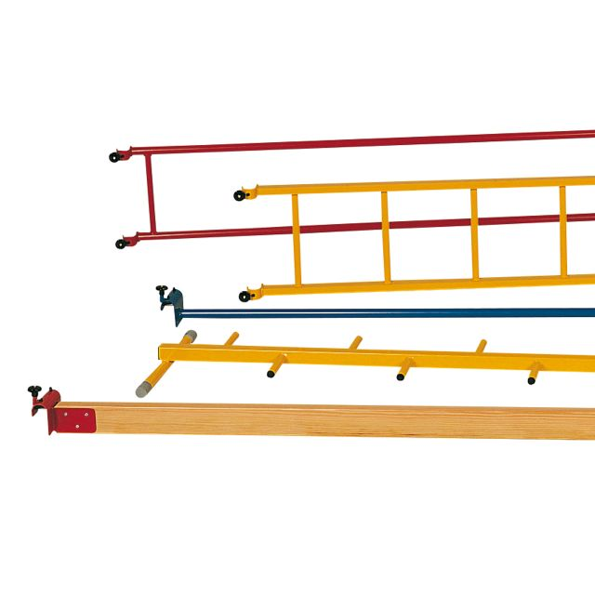
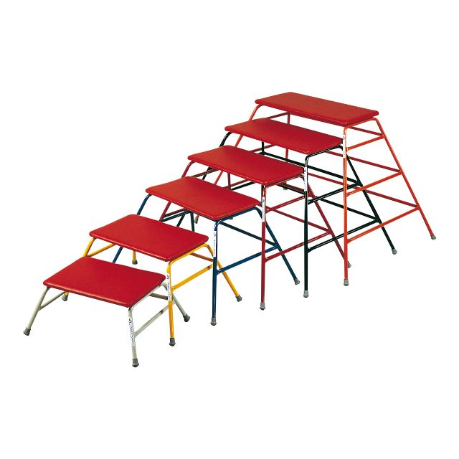
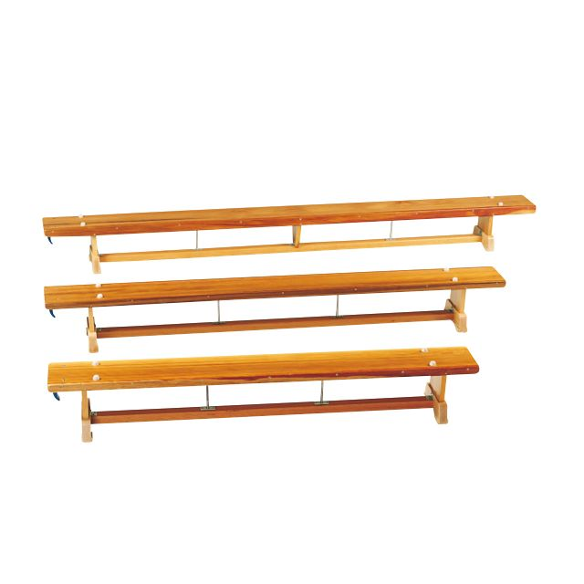
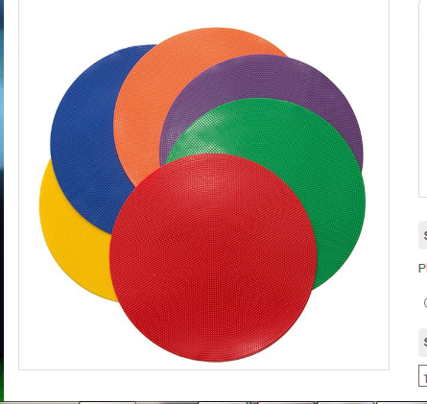
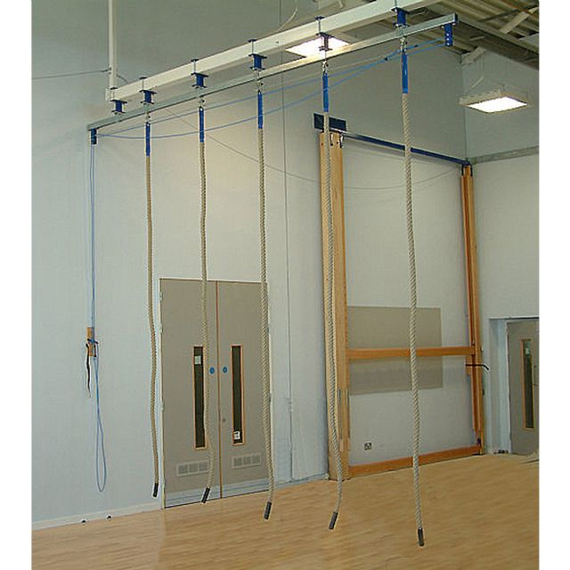
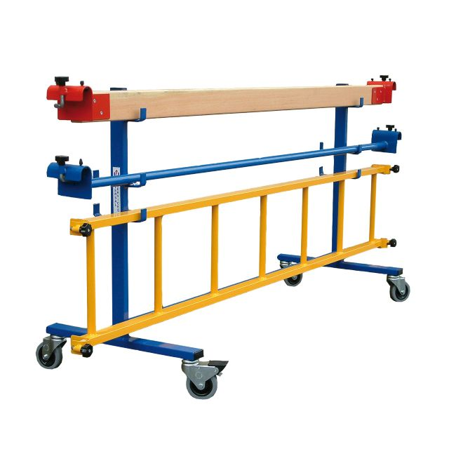

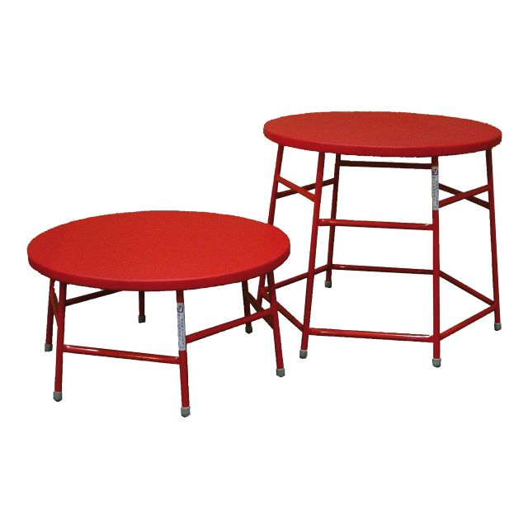

Apparatus layouts

Slide 28
Barnet Schools Dance Festival March 2027
Barnet Schools' Dance Festival 2026

Slide 29
Enrichment
September 2026, Ofsted's updated inspection toolkit comes into use in schools across England
Personal Development and Wellbeing is a distinct evaluation area. Inspectors are asked to consider the wider opportunities and experiences schools provide, whether pupils develop confidence, resilience and the knowledge to stay mentally and physically healthy, and whether enrichment is purposeful and varied
Ofsted's updated inspection toolkits will take account of the new Enrichment Framework and 8 Benchmarks Enrichment benchmarks - GOV.UK
Enrichment for All website has case studies , toolkit etc

Slide 30
8 Benchmarks:
A strategically aligned enrichment offer
A broad and well-rounded enrichment offer
A well-communicated enrichment offer that celebrates participation and achievement
An enrichment offer shaped by the school
An accessible and engaging enrichment offer
An enrichment offer that works in partnership
An outcomes-focused enrichment offer
A continually improving enrichment offer

Slide 31
How well do you actually understand your enrichment offer?
The Enrichment Framework places considerable emphasis on accessibility, engagement and inclusion. Schools need to understand whether opportunities are reaching different groups of pupils and identify barriers to participation.
Registers can help answer: What do you offer? Who participated? In what? How often? Good demographic analysis can reveal inequalities that might otherwise remain hidden.
But that's where the limitations of the register begin.
Two pupils can attend exactly the same activity and have completely different experiences. One leaves feeling confident, connected and eager to return. The other leaves feeling peripheral, unsuccessful and less likely to participate again.

Slide 32
What happened when they got there?
The Enrichment Framework and benchmarks are not simply asking schools to provide more things for young people to do
Are young people enjoying what is offered?
Do they feel they belong?
Are they developing confidence?
Do they have agency and choice?
Are experiences relevant to them?
Are they becoming more motivated to participate (or less)?
And what about the pupils who aren't participating at all?
Notes:
A register might identify those not participating . It rarely explains them.
Cost, transport and timing may be barriers. But so might confidence, previous experiences, friendship groups, cultural expectations, perceived competence or simply a feeling that “this isn't for people like me.”
If we only measure attendance, much of this remains invisible.

Slide 33
From provision to outcomes
The new framework encourages schools to think about what enrichment is actually intended to achieve.
The suggested outcomes go considerably beyond participation. They include engagement, educational outcomes and progression, social and emotional development, physical and mental wellbeing, belonging, essential skills and engagement with the wider community.
Schools are encouraged to assess their provision against the benchmarks as part of an ongoing process of monitoring, evaluation and improvement.
Therefore not only do we ask What did we provide?
We should also be asking: Who experienced it? What difference did it make? Who didn't benefit? And what should we do differently as a result?
Notes:
Start with outcomes for enrichment task – what are outcomes – diamond 9 them as a group

Slide 34
The bit that really matters: what happens next?
This is perhaps the biggest opportunity created by the new framework. Evidence shouldn't exist simply to satisfy an inspector.
Imagine discovering that pupils eligible for pupil premium are significantly less likely to participate in enrichment. Useful information. But its value lies in what happens next.
Why aren't they participating?
What could the school change?
Did that change work?
Or perhaps participation is high, but a particular group consistently reports lower enjoyment or belonging.
Again, the interesting question isn't whether that can be placed in an SLT report.
It's whether the school can respond while there is still an opportunity to make a difference.
That's the loop schools should be trying to create:
Understand → Respond → Learn → Improve
This is what a continually improving enrichment offer should look like in practice i.e beyond the register
Beyond the Register: What should schools actually know about their enrichment offer?

Slide 35

Swim England resources
Resources - Swim England School Swimming

Slide 36
Water safety and safe self rescue
School Swimming Clarification - Swim England School Swimming
Fall-in entry and recover to surface*.
Float on the back with minimal movement for 60 seconds without floatation equipment*.
Rotate from floating on the back to a vertical position*.
Tread water for 30 seconds*.
Whilst treading water, Signal for help once, by extending one arm above the head and simultaneously shouting for help then returning the arm to the water to continue to tread water*.
Swim (without floatation equipment) 15m to a floating object, using a recognised personal survival stroke (head up long arm front paddle or lifesaving backstroke)
Retaining the floating object take up the Heat Escape Lessening Position/Posture for 30 seconds*.
Form a huddle position as a group for 30 seconds*
Swim 15m to exit the water unaided*

Slide 37
What is your swim programme for this year?

Slide 38
AfPE
Safe Practice – AfPE bulletins – can pupils / parents / carers choose to opt out of PE? AfPE guidance.
Membership Join NOW
Quality Mark

Slide 39
Further opportunities and CPD
CPD bespoke sessions
BG course @ Highgate School 7th and 14th October – 2 full days – includes teaching resource – building capacity – who to send?
Next PESL network session Thursday 21st January 2027 (9-12pm)

Slide 40
AfPE opportunities
Quality Mark – podcast resource Association for Physical Education

